Slide 1
Silver Salisbury’s
Consultation with Older People

Slide 2
Hello!
Each September Silver Salisbury runs a programme of events to celebrate age & showcase activities for older people.
To help plan our programmes we wanted to know how older people were feeling, what they wanted to do & what would make them more likely to get involved.
Irene Kohler
Salisbury’s Older People’s champion

Slide 3
The consultation
16% of questionnaires completed on-line
Feedback from focus groups to develop a paper & on-line questionnaire.
600 paper questionnaires shared through older people’s housing, support, activity & volunteer groups, newsletters, religious groups, libraries & personal contacts.
Completed 8th June to 9th September 2021
RECEIVED
243 responses
Visits to local housing associations, clubs, coffee mornings and events.

Slide 4
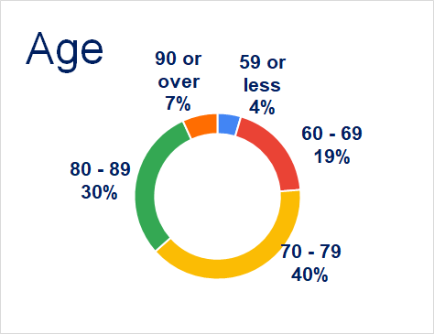
Our respondents
62% lived alone
8% were carers
12% had carers
39% lived in a development
for older people

Slide 5
How people felt

Slide 6
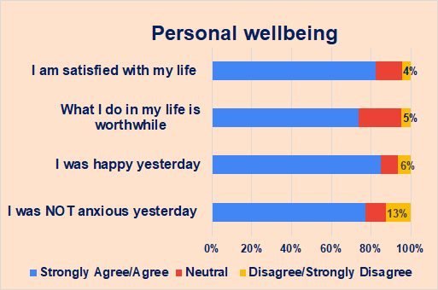

Slide 7
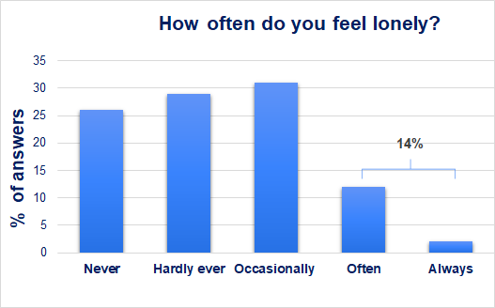
14% of our older people often or always felt lonely.
Nationally, 7.2% of adults often or always felt lonely ( Feb ‘21 ONS Opinions & Lifestyle Survey).

Slide 8
Activities & interests

Slide 9
What older people most want to do over the next 6 months
74%
Meet family & friends
72%
Go to a pub or restaurant
52%
Go to the theatre or a concert
42%
Group fitness activities
35%
Group creative activities
36%
Social clubs, including lunch clubs

Slide 10
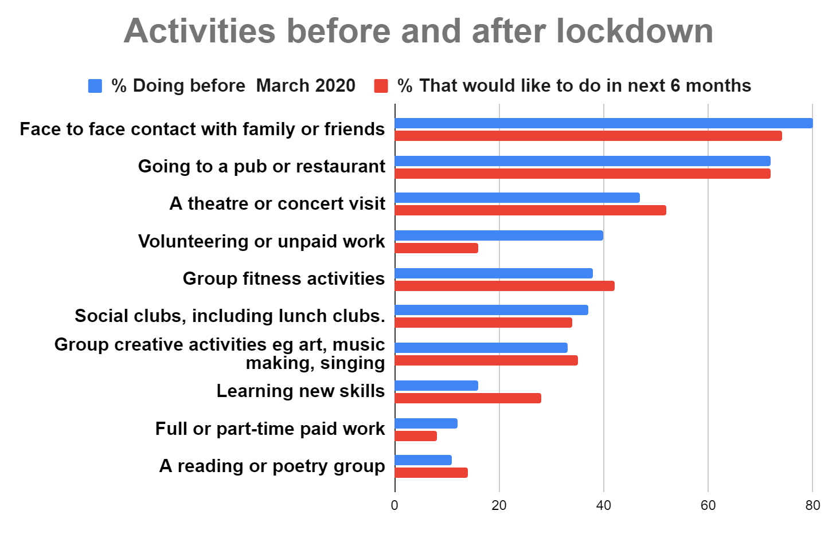

Slide 11
Barriers & Enablers

Slide 12
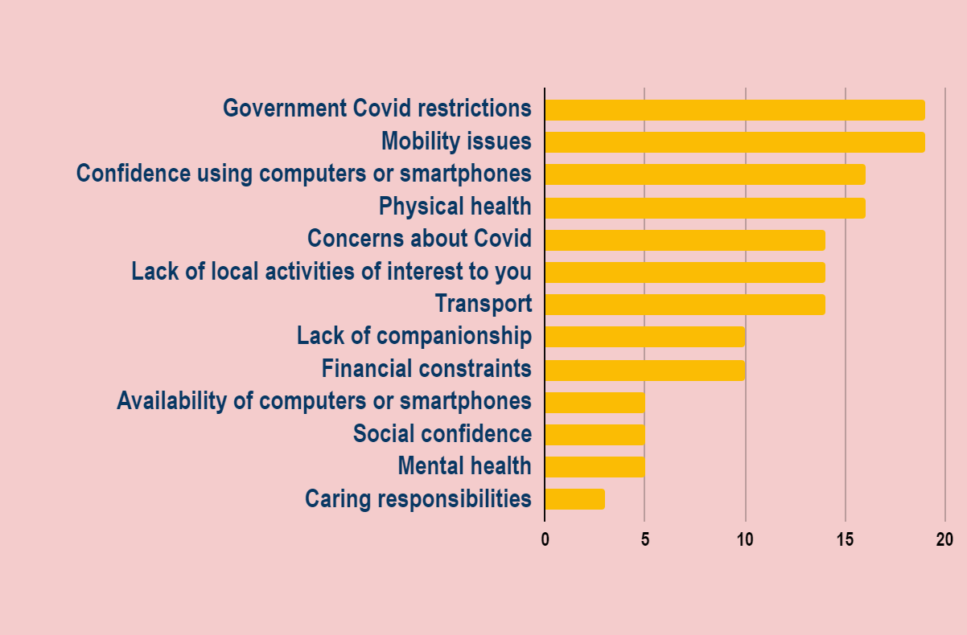
Things preventing people living the life they’d like to lead
% People scoring 4 or 5 on a scale of 1-5, where 1 is Not at all and 5 is completely

Slide 13
In your own words, what one thing would improve your quality of life?
Top themes & quotes
Companionship (25 people)
‘To get out and meet other people’
‘More opportunities to meet, chat
& listen to people’
‘Finding someone compatible just to do things with’
‘Having moved two years ago to Salisbury I don't know anyone & I have not had the opportunity of joining organisations’
Easing of Covid rules
(16 people)
‘Return to 'normal' living’
‘Being able to have people back in the house’
‘Socialising again’
‘Never having to have another lockdown’
Better Health (19 people)
‘Health!! To be pain free or at least to have reduced pain’
‘Better health’
‘New legs would be lovely’
‘Husband's health’

Slide 14
What would make people more likely to take part in group activities? Top 6
1
Local venues
5
Commitment-
free trial sessions
54%
2
More info on activities
35%
45%
6
Someone to go with
34%
=3
Knowing that older people are welcome
=3
Low cost or free sessions
37%
37%

Slide 15
What would make people more likely to take part in group activities? Others
10
Knowing the building is easily accessible
7
Knowing there are plenty of toilets
8
Better transport arrangements
21%
32%
Nothing
11%
26%
12
Knowing my religious needs are catered for
9
Outdoor activities
11
Virtual meetings that can be accessed
from home
9%
25%
7%

Slide 16
Points from discussions
Many were experiencing big lifestyle changes eg bereavement, re-location, life without a car, changes to caring responsibilities
‘Local activities’ meant very local eg within a residential complex
Activities of an hour or less were easier to fit round caring responsibilities

Slide 17
More points from discussions
Wheelchair access could be a problem eg ‘The important point. There are no easy footpaths in Amesbury for wheelchair users!!’
Some people need lots of encouragement and multiple contacts
to help them take participate.
People felt it was a great programme but once a year was not enough!

Slide 18
Diversity & Locality

Slide 19
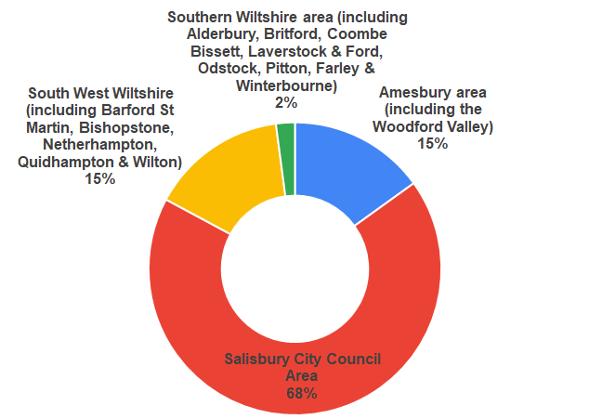
Where our respondents live
Around 63K people live in the built up areas of Salisbury (73%) Amesbury (20%) & Wilton (7%).
25% of Wilton is aged 65 or over, 22% of Salisbury & 17% of Amesbury. (UK 0NS 2019)

Slide 20
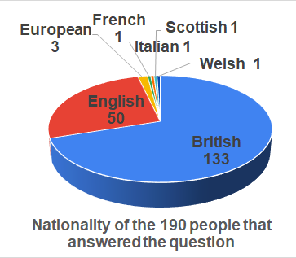
Nationality & Ethnicity
99.5% respondents described their ethnic background as white.
We aimed to increase diversity by recruiting 2 Polish & Romanian outreach consultants; translating questionnaires & holding Polish & Romanian-themed garden parties.
We also contacted Salisbury Muslim
Assocation, Jamyang Salisbury & the Muslim Women’s Assocaition.
This gave useful future contacts but
not completed questionnaires.

Slide 21
Next steps & credits
Share with Silver Salisbury Group, Council Community Managers &
interested groups
1
Agree actions for Silver Salisbury & next year’s programme
2
Thanks to the National Lottery Community Fund for funding this work, to SlidesCarnival for the free presentation template and to all those that shared their views.

